Slide 1
ATLASSIAN SUMMIT 2012
USER MACROS:
MAKING YOUR OWN CHANGES TO CONFLUENCE
Steve Goldberg
Technical Writer
stevegoldberg@venda.com

Slide 2
WTF ARE USER MACROS?
Re-usable snippets that enhance the functionality of Confluence.
Wiki markup, HTML, CSS, JavaScript, Velocity Templating Language, and other macros.
Great for page templates, getting around quirks, and solving those “I wish there was a plugin for…” moments.
Easy to get started.
Free and support them yourself.

Slide 3
FEATURES
Supports wide range of common web techs and Velocity.
Appear in the Macro Browser like regular macros.
Input from editors when writing documentation.
Input from Confluence.
Conditional logic and variables.

Slide 4
SIMPLE USER MACROS
Stitch together existing macros, simple styling and objects.
Example uses:
  Add a bit of CSS to a single page
  Captions for images and tables
  Table column width setter
  ‘Under development’ note box.

Slide 5
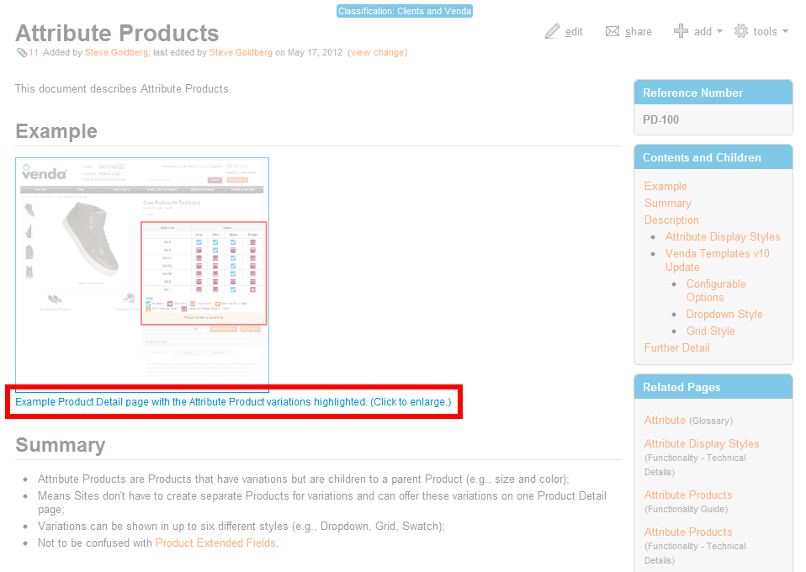

Slide 6
SIMPLE USER MACROS: CAPTIONS
Avoids using in-page styling.
Style defined externally with stylesheet.
Less hassle for editors.
Less hassle when styling needs to change.

Slide 7
COMPLEX MACROS: “PERMCHECK”
Two similar questions I got asked:
  How can I know what permissions apply to space when I’m not an admin?
  How can I know quickly if I can share this page with a client?

Slide 8


COMPLEX MACROS: “PERMCHECK” #2
Solution:
  Make important space-level permissions visible.
  To do this, create a dynamically generated, informative widget visible on every page.

Slide 9
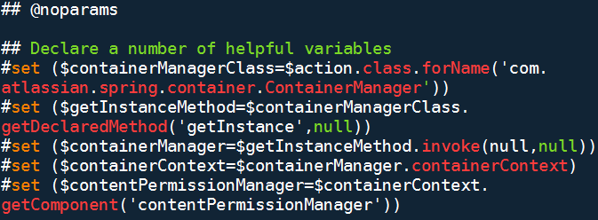
DECLARE A NUMBER OF HELPFUL VARIABLES

Slide 10
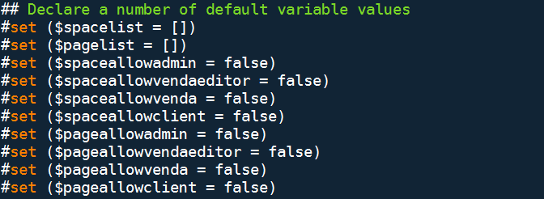
DECLARE A NUMBER OF DEFAULT VARIABLES

Slide 11
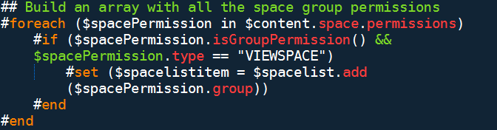
BUILD AN ARRAY WITH ALL THE SPACE GROUP PERMISSIONS

Slide 12
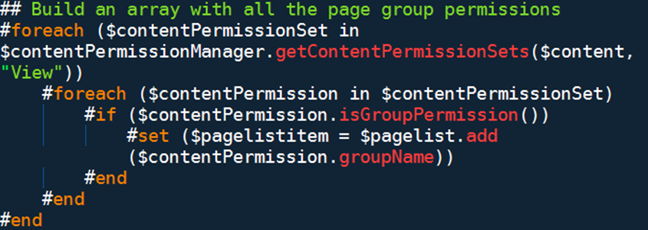
BUILD AN ARRAY WITH ALL THE PAGE GROUP PERMISSIONS

Slide 13
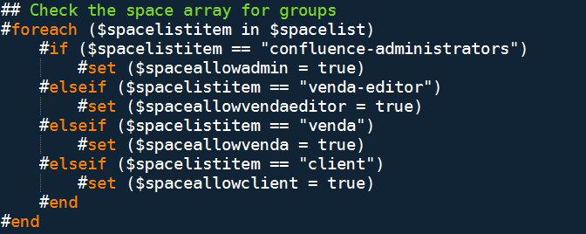
CHECK SPACE ARRAY FOR SPECIFIED GROUPS

Slide 14
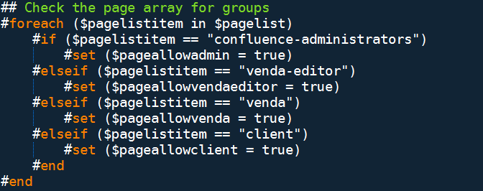
CHECK PAGE ARRAY FOR SPECIFIED GROUPS

Slide 15
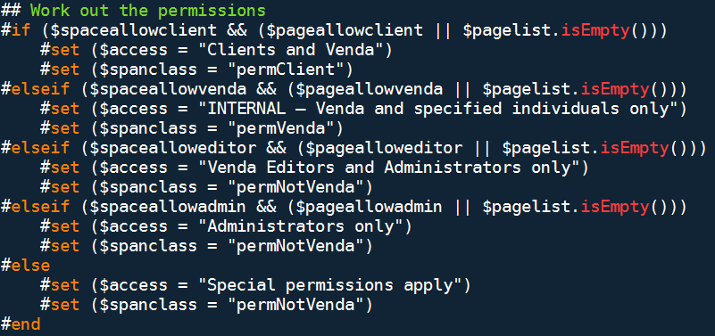
WORK OUT THE PERMISSIONS

Slide 16
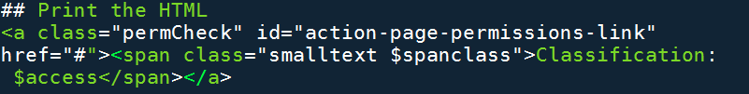
BUILD THE WIDGET WITH HTML

Slide 17
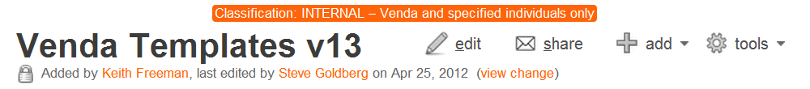
WIDGET SUMMARY
No plugin solution available/viable.
Used own knowledge and community for support.
Implemented it myself; support it myself.
Free.

Slide 18
MACROS ARE EASY
Alleviate your frustration.
Start with existing macros, basic HTML, and CSS.
Improve upon it by reading up on more complex HTML, JavaScript, and Velocity.
Use them for templates to push changes globally at once.

Slide 19
MACRO COMMUNITY AND HELPFUL LINKS
Join me and others in aggregating, sharing, and improving macros:
Macro introduction: http://confluence.atlassian.com/x/UolYDQ.
Atlassian Answers: https://answers.atlassian.com/.
VTL Guide: http://velocity.apache.org/engine/releases/velocity-1.6.
Submit your macros or fork mine:
GitHub: https://github.com/stevegoldberg/ConfluenceMacros.
Thank you.

